Slide 1
KANNIHA R
821721243027
BTECH., ARTIFICIAL INTELLIGENCE AND DATA SCIENCE – III YR
SIR ISSAC NEWTON COLLEGE OF ENGINEERING AND TECHNOLOGY

Slide 2
PROJECT TITLE
IMAGE CLASSIFICATION USING CONVOLUTIONAL NEURAL NETWORK (CNN)

Slide 3


AGENDA
The agenda of image classification using Convolutional Neural Networks (CNNs) is to automate the process of categorizing images into predefined classes or labels. CNNs extract meaningful features from raw pixel data through convolutional layers, enabling hierarchical learning of patterns. This project includes several key tasks:
-Preprocessing input images.
-Designing CNN architectures.
-Training the network on labeled data.
-Fine-tuning model parameters.
-Evaluating the model's accuracy on unseen data.
Ultimately, the goal is to develop robust and efficient systems capable of accurately classifying diverse images across various applications, from medical diagnosis to autonomous driving.

Slide 4

PROBLEM STATEMENT
Image classification using Convolutional Neural Networks (CNNs) revolves around developing a robust system capable of accurately categorizing images into predefined classes or categories. CNNs aim to address the challenge of automatically learning and extracting meaningful features from raw image data, enabling effective classification.
This entails overcoming issues such as variations in lighting, scale, orientation, and occlusion within images, which can complicate accurate classification. The ultimate objective is to create a CNN model that can generalize well to unseen images, providing reliable classification results across diverse datasets and real-world scenarios, thereby facilitating numerous applications in fields like healthcare, security, and autonomous driving.

Slide 5

PROJECT OVERVIEW
The project involves implementing Convolutional Neural Networks (CNN) for image classification tasks. CNNs are deep learning models specifically designed to process structured grid-like data, such as images. The project aims to train the CNN on a dataset containing labeled images to accurately classify new, unseen images into predefined categories.
It typically involves several steps including data preprocessing, model architecture design, training, and evaluation. The trained CNN learns hierarchical representations of features within images, enabling it to discern patterns and make predictions. The ultimate goal is to develop a robust and efficient image classification system applicable across various domains and applications.

Slide 6
WHO ARE THE END USERS?
-In healthcare, doctors and medical professionals utilize CNN-based image classification for diagnosing diseases from medical images such as X-rays, MRIs, and CT scans.
-In autonomous vehicles, CNNs are employed to detect objects on roads, ensuring safety for passengers and pedestrians.
-In E-commerce platforms leverage CNNs to enhance user experience through image-based search and recommendation systems.
-In Security agencies employ CNNs for surveillance and facial recognition tasks.
Additionally, social media platforms utilize CNNs for content moderation and personalized content delivery. Overall, CNN image classification serves diverse end users across numerous sectors, facilitating automation, decision-making, and efficiency.
The end users of image classification using Convolutional Neural Networks (CNNs) vary across industries and applications.

Slide 7

YOUR SOLUTION AND ITS VALUE PROPOSITION
This project solution leverages Convolutional Neural Networks (CNNs) to accurately categorize images with remarkable efficiency. By harnessing the power of deep learning, this model learns intricate patterns and features within images, enabling precise classification across diverse datasets.
Value proposition of this model lies in delivering robust performance, high accuracy, and scalability. With CNNs, we offer a streamlined approach to image classification, automating complex tasks with minimal human intervention. Whether it's identifying objects, recognizing faces, or classifying scenes, our solution provides a reliable framework for various applications, from medical diagnostics to autonomous vehicles, enhancing productivity and decision-making processes.

Slide 8

THE WOW IN YOUR SOLUTION
In the realm of image classification, Convolutional Neural Networks (CNNs) evoke sheer wonder with their unparalleled efficacy. CNNs revolutionize image analysis by mimicking the human visual cortex, discerning intricate patterns and features within images. Their hierarchical architecture comprises convolutional layers, extracting local features, followed by pooling layers, reducing dimensionality while preserving essential information.
Through repeated convolution and pooling, CNNs capture hierarchical representations, culminating in fully connected layers for classification. Their adaptability to diverse datasets, coupled with techniques like data augmentation and transfer learning, endows CNNs with exceptional accuracy and generalization. Thus, CNNs stand as the epitome of innovation, eliciting awe in their prowess for image classification tasks.
3/21/2024 Annual Review
8

Slide 9
MODELLING
Image classification using Convolutional Neural Networks (CNNs) involves a multi-layered architecture designed to effectively extract features from input images and classify them into predefined categories. The model typically consists of convolutional layers for feature extraction, followed by pooling layers for dimensionality reduction, and fully connected layers for classification.
Teams can enhance understanding by adding wireframes illustrating the network's structure, highlighting the flow of information from input to output layers. CNNs have revolutionized image classification tasks due to their ability to automatically learn hierarchical representations, making them invaluable in various fields such as medical imaging, autonomous vehicles, and facial recognition.
9

Slide 10

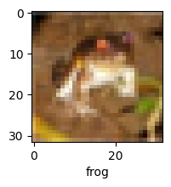
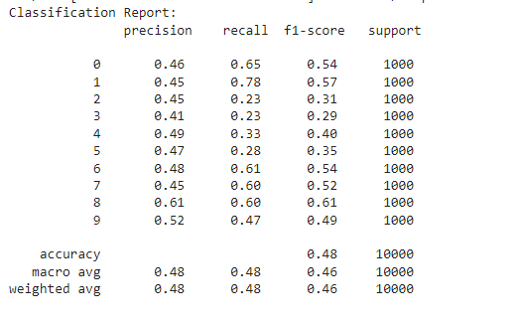

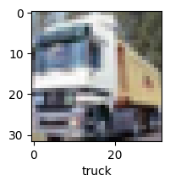

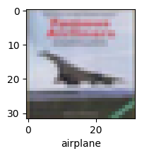
RESULTS
Predictions
Sample test outputs
Classification report
Test loss and test accuracy
Testing the model
10

